Slide 1
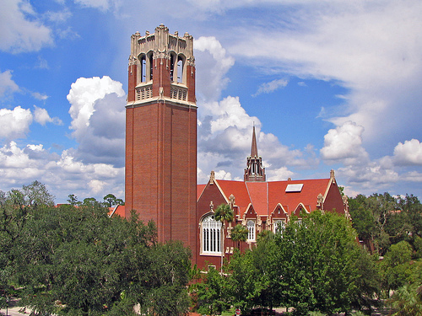
PaperTree- A Research Paper Recommender
Cloud Computing & Storage
Team 11- NeXuS

Slide 2

Table Of Contents
What is PaperTree?
Related Work
System Architecture
Technologies Used
Data Set
How PaperTree Recommends?
Application Process
Algorithms & Techniques
Hadoop Results
Performance Evaluation
DEMO
Conclusion
Future Work

Slide 3

What is PaperTree?
It’s a Recommender system focused on Recommending Research Papers.
Provides its user’s with multitude of research papers to study.
It recommends papers to the users based upon:
a) User’s interests
b) Keeps track of User’s Readings History
c) Readings of other users with Similar Interests
Allows users to search for Research Papers based on keywords.

Slide 4

How PaperTree is Different?
Existing Systems-
Search for Research Papers based on keywords.
Elevated System (PaperTree)-
It provide its users a Personalized Research Paper Recommender System.
A User-centric system with dedicated profiles for its users.
Dashboard- for users to explore research papers from other domains.
Recently Viewed Papers –
i) Reduces search time
ii) Easy to add references

Slide 5
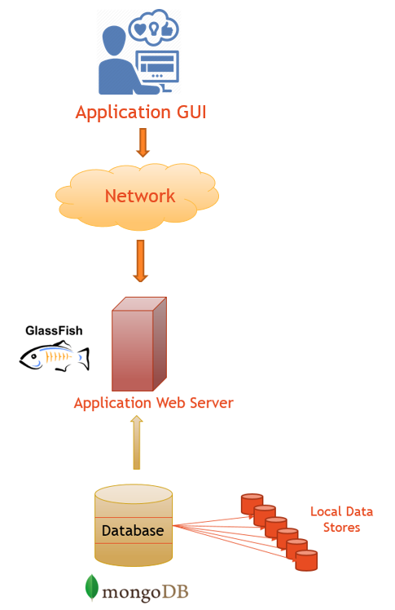


System Architecture
Periodically Dumps Cluster Output Files

Slide 6
Technologies Used
Frameworks-
Apache Hadoop 2.6.0
Apache Mahout 0.9
Microsoft Expressions Web 4
NetBeans IDE 8.0
Server
Glass Fish 4.1
Back End-
Database- Mongo DB 3.0 Shell & Service
Languages-
Java
JQuery
HTML5
CSS,
Java Script
JSP
Servlets

Slide 7

Data Set
National University Of Singapore’s Data Set
Available on GitHub
Link- http://www.comp.nus.edu.sg/~sugiyama/SchPaperRecData.html
Data is described as feature vectors.
Two Types of data sets available-
Data Set 1 (Large Dataset)- 100,531 papers, 50 researcher’s interest.
Data Set 2 ( Small Dataset)- 597 papers, 15 junior & 13 senior researcher’s interest

Slide 8
How Recommends?
Data Set
Users Information
Research Paper Similarity
Users Interest’s Similarity
User’s History of Readings
Content Based Filtering
User Based Collaborative Filtering
Recommendation

Slide 9

Application Process
Data Preprocessing
Junk Data- Numerical values Removed
Data Set
Apache Hadoop
Apache Mahout
Using Mahout’s seqdirectory Utility
Sequential File Creation
Using Mahout’s seq2sparse Utility
TF * IDF Vector Creation
K- Means Clustering
Clusters Folders from every Iteration
Research paper Clusters

Slide 10

TF * IDF Vector Creation
TF- Term Frequency
Number of times a term occurs in a document.
IDF- Inverse Document Frequency
Measure of information a word provides.
Formula to compute IDF-
Higher the value of TF* IDF, more important the word is.

Slide 11

K- Means Clustering
Selection of Initial Centroids (Randomly)
Measure of similarity between two vectors
Cosine Similarity Calculation with Centroids
Assigning papers to clusters based on similarity value
Recalculating Centroids, till it Converges

Slide 12
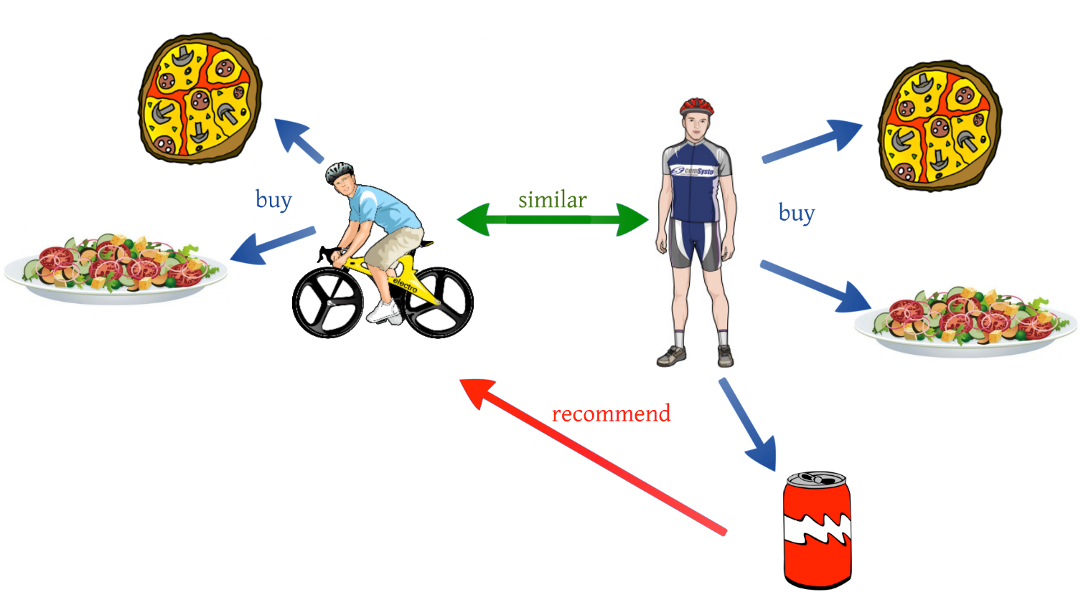
User Based Collaborative Filtering
Making automatic predictions about user’s interests by collecting preferences from many users
Manhattan Distance
Summation of difference in term frequencies in two different documents.

Slide 13
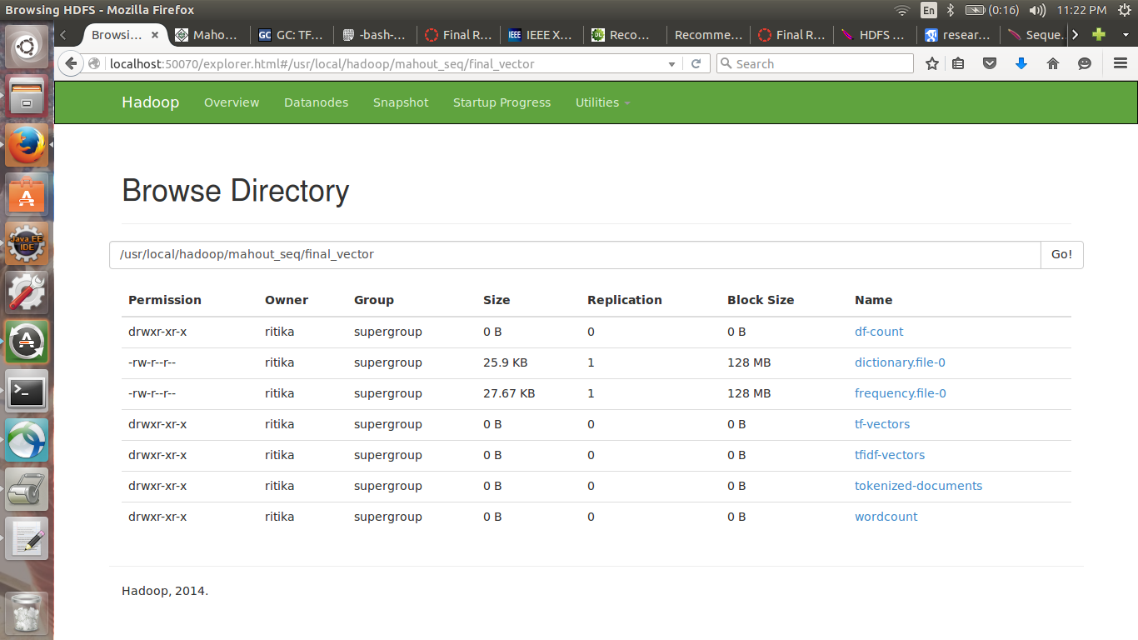
Clusters Created Via Hadoop (Local Cluster)

Slide 14
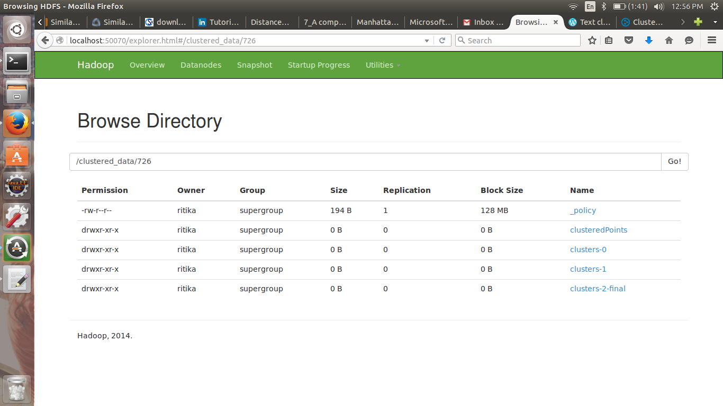

Slide 15

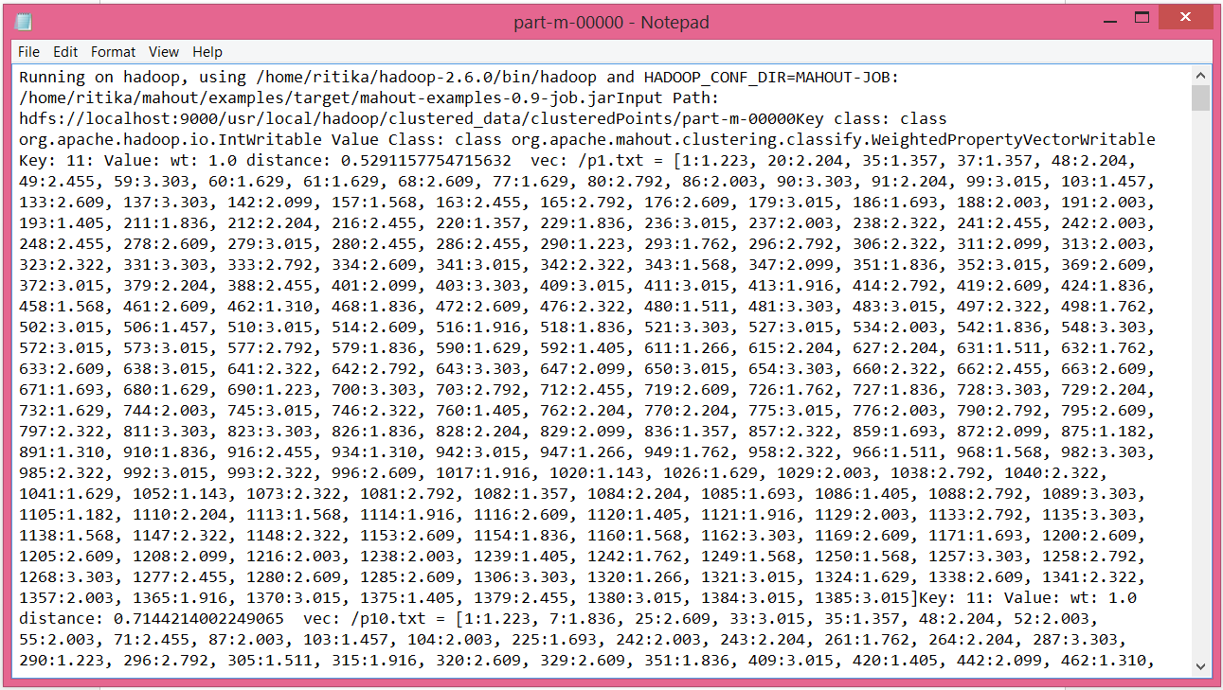
Hadoop Results

Slide 16
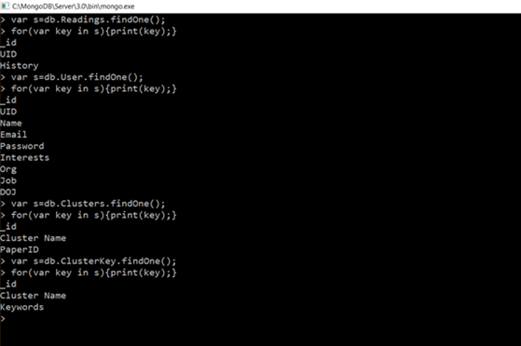
Database Schema (MongoDB)

Slide 17
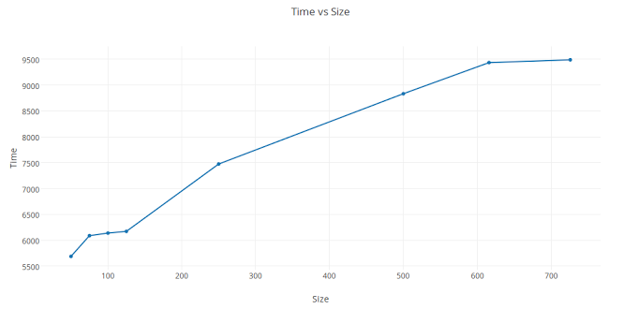
Performance Evaluation
Cluster Creation Time Vs Data Size-
Plot shows running time of k-means with increasing Data Size.
Increases for higher data sizes.

Slide 18
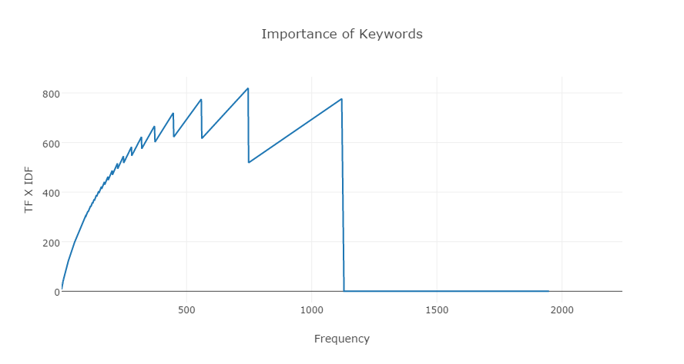
2. TF * IDF Vs Frequency-
Plot shows importance value decreases if frequency of that word in research papers increases.

Slide 19
3. Cluster Density Vs Data Size-
Plot shows intra-cluster density values for different data sizes.
Intra- Cluster Density value varies from 0 to 1.
Remains constant for higher data sizes.

Slide 20
Application Modules
Access Module:
This module consists of Login, Sing Up and Authentication.
Search Module:
This module consists of search and advanced search.
Recommender Module:
This module is the core of the application and performs the task of recommending paper to users based on their interests and access history.
Account Settings Module:
This module consists of feature to allow and change the Email address and Password associated with an user account.

Slide 21
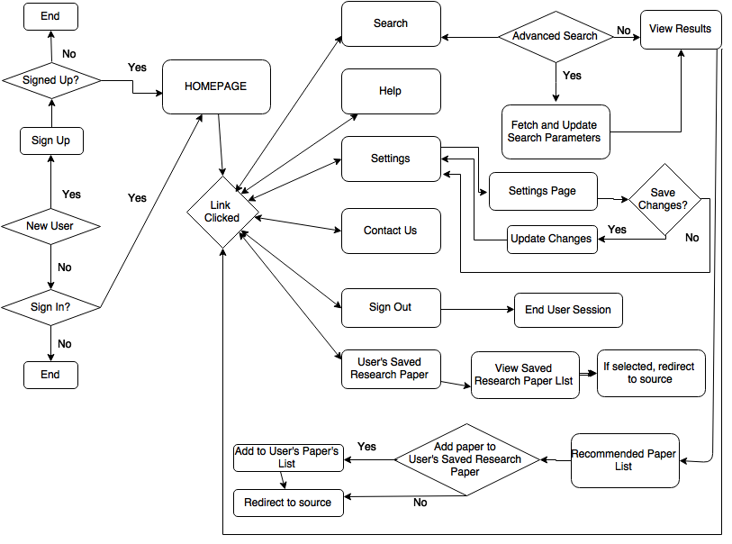
Application Flowchart

Slide 22
DEMO

Slide 23
Conclusion
PaperTree provides highly personalized user experience
It recommends Research Papers efficiently.
It provides accurate recommendations based on keywords and user’s interests.
Application GUI is easy to understand.
It provides ease of access to its users.

Slide 24


Future Work
Mobile Application for PaperTree.
Planning to include Ratings based Recommendations.
Research Paper upload & download capability for users.

Slide 25

Questions???

